Slide 1

Corona Virus
Analysis
By Tanya Sharma

Slide 2
Section 1: Project Overview
Section 2: Data Analysis using SQL
Section 3: Key Insights

Slide 3
Section 1: Project Overview
Objective: Applying data analysis skills in a
real-world context to analyze a CORONA VIRUS dataset.
Derive meaningful insights, and present findings.

Slide 4
Impact of Pandemic
The CORONA VIRUS pandemic has significantly affected public health, creating an urgent need for data-driven insights to understand the spread of the virus.

Slide 5
Dataset Description:
Description of each column in dataset:
Province: Geographic subdivision within a country/region.
Country/Region: Geographic entity where data is recorded.
Latitude: North-south position on Earth's surface.
Longitude: East-west position on Earth's surface.
Date: Recorded date of CORONA VIRUS data.
Confirmed: Number of diagnosed CORONA VIRUS cases.
Deaths: Number of CORONA VIRUS related deaths.
Recovered: Number of recovered CORONA VIRUS cases.

Slide 6
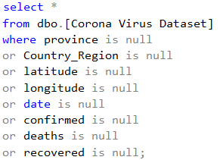
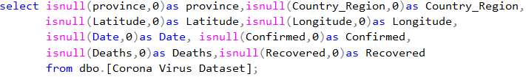
Section 2: Data Analysis using SQL
Handling NULL Values
Q1: Check for NULL values in the dataset.
Q2: If NULL values are present, update them with zeros for all columns.

Slide 7

Data Overview
Q3: Check the total number of rows in the dataset.
Q4: Identify the start and end dates of the dataset.
Q5: Determine the number of months present in the dataset.

Slide 8
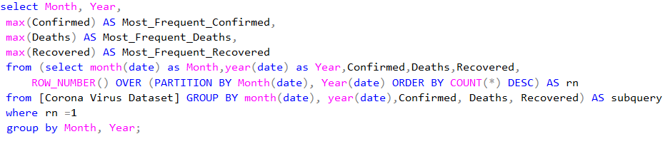
Monthly Analysis
Q6: Find the monthly average for confirmed, deaths, and recovered cases.
Q7: Identify the most frequent values for confirmed, deaths, and recovered cases each month.

Slide 9
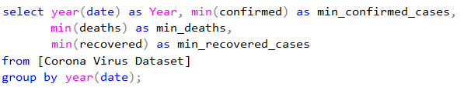
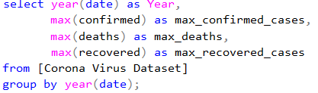
Yearly Analysis
Q8: Find the minimum values for confirmed, deaths, and recovered cases per year.
Q9: Find the maximum values for confirmed, deaths, and recovered cases per year.

Slide 10
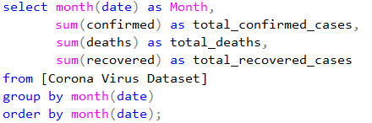
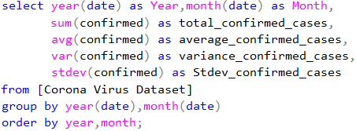
Total Cases Analysis
Q10: Determine the total number of confirmed, deaths, and recovered cases each month.
Q11: Analyze the spread of the virus with respect to confirmed cases.

Slide 11
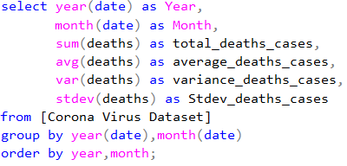
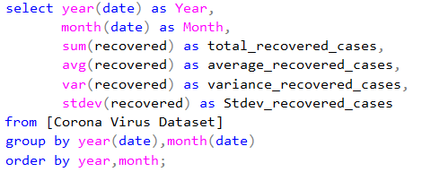
Case Analysis
Q12: Analyze the spread of the virus with respect to death cases per month.
Q13: Analyze the spread of the virus with respect to recovered cases.

Slide 12
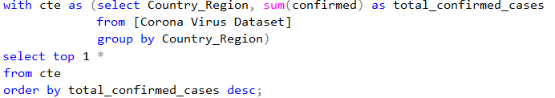
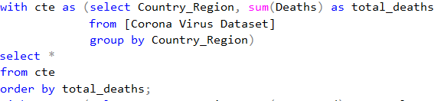
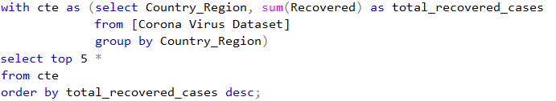
Country Analysis
Q14: Find the country with the highest number of confirmed cases.
Q15: Find the country with the lowest number of death cases.
Q16: Identify the top 5 countries with the highest number of recovered cases.

Slide 13
Section 3: Key Insights
Summary: The analysis provides crucial insights into the spread and impact of the CORONA VIRUS, enabling informed decision-making and proactive measures.
Impact: The analysis aids in understanding the severity of the pandemic, identifying trends, and highlighting areas for targeted interventions.
Conclusion: The analysis serves as a valuable tool in combating the CORONA VIRUS pandemic, emphasizing the importance of data-driven approaches in crisis management.

Slide 14

THANK YOU

